Slide 1







An Application based Data-Driven AI Fitness Trainer integrating Deep Learning Algorithms and Computer Vision
Group No. 15
Student ID | Group member
21107019 | Riya Rajesh Sawant
21107012 | Rutuja Patil
21107006 | Tanvi Panchal
22207008 | Sneha Sabat
Project Guide
Ms. Anagha Aher & Ms. Ashwini Rahude

Slide 2
Contents
Abstract
Introduction
Objectives
Literature Review
Research Gap
Problem Definition
Scope
Technological Stack
Proposed System Architecture/Working
Prototype Design Demonstration
Implementation Status
Review Suggestions

Slide 3

Abstract
Generic workout routines, lack of personalized advice, and time management issues often lead to ineffective workouts and frustration. The AI Fitness Trainer addresses this issues by offering personalized recommendations through Deep Neural Networks (MLP), tailored to each user’s fitness goals. It combines Mediapipe, CVzone, and CNN for advanced pose estimation with real-time feedback from a voice assistant. Additionally, users can track progress and performance through a dashboard and leaderboard, ensuring an engaging and effective fitness experience.

Slide 4

Introduction
Modern fitness enthusiasts seek personalized guidance to achieve their unique health and fitness goals, but traditional programs often lack the adaptability to cater to individual needs, leading to decreased motivation and inconsistent results.
Existing fitness solutions, such as mobile apps and wearable devices, typically offer generic workout plans and manual tracking, failing to deliver the personalized, real- time feedback necessary for effective workouts and goal achievement.
Inadequate personalization, lack of real-time feedback, and low user engagement are
persistent challenges in current fitness solutions.
A dynamic and interactive fitness solution is needed to address these limitations and provide precise, personalized guidance.
Motivation
Traditional fitness programs offer generic advice and manual tracking, lacking personalization for individual health conditions, goals, and progress.
The AI Fitness Trainer uses artificial intelligence and real-time data analysis to provide personalized recommendations and instant feedback, improving user engagement and fitness outcomes.

Slide 5

Objectives
To provide real-time feedback on exercise form, gesture, posture, and accuracy percentage, as well as to detect and track exercises performed, calculate calories burned, and address user slacking off during workouts using deep learning-powered human pose estimation, computer vision technologies and convolutional neural networks (CNNs).
To provide personalized workout routines based on the user's health conditions, age, fitness -
based goals using a deep learning-based Multilayer Perceptron network.
To create a dynamic and customizable diet plan tailored to the user's health conditions, age, preferences, height, weight, and allergies using a deep learning-based Multilayer Perceptron network.
To generate comprehensive weekly performance reports by integrating data from workouts and diet recommendations using data aggregation, descriptive statistics, and data visualization techniques, and to enhance user engagement and motivation through a system that allows users to log their progress and participate in leaderboards.

Slide 6
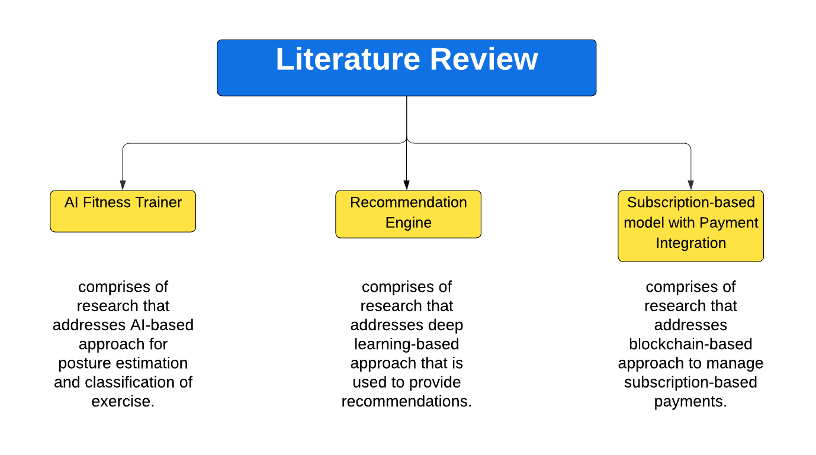
Literature Review
The literature review is presented in the sequence illustrated in the figure: AI Fitness Trainer, Recommendation Engine, and Subscription Model with Payment Integration.
Figure 1: Categorized literature review

Slide 7
Literature Review
Sr.no | Title | Author(s) | Year | Methodology | Drawback
1 | Robust Intelligent Posture Estimation for an AI Gym Trainer using Mediapipe and OpenCV [1] | Venkata Sai P Bhamidipati Ishi Saxena Mrs. D. Saisanthiya Mrs. D. Saisanthiya Dr. Mervin Retnadhas | 2023 | The paper presents an AI-based approach for posture estimation in gym workouts. It utilizes a combination of real-time video processing, keypoint detection, and pose estimation techniques. The system was tested on various exercises to evaluate accuracy. | Limited to predefined exercises: The system may not perform well with exercises or movements outside the trained dataset. Dependence on good lighting and camera quality: Performance may degrade in poor lighting or with low-resolution cameras.
2 | AI Trainer: Autoencoder Based Approach for Squat Analysis and Correction [2] | Mukundan Chariar Shreyas Rao Aryan Irani Shilpa Suresh C S Asha | 2023 | This paper presents a method for classifying squat types and recommending the right squat version. This study uses MediaPipe and a deep learning-based technique to decide if squatting is good or bad. | Limited to squats: The system may not perform well with exercises or movements outside the trained dataset.
3 | A Framework for Recognition and Prediction of Human Motions in Human-Robot Collaboration Using Probabilistic Motion Models [3] | Thomas Callens, Tuur van der Have Sam Van Rossom Joris De Schutter Erwin Aertbeli | 2020 | This paper presents a framework for recognition and prediction of ongoing human motions. The predictions generated by this framework could be used in a controller for a robotic device, enabling the emergence of intuitive and predictable interactions between humans and a robotic collaborator. | The performance of the phase speed estimation module was rather low. Limited to certain domain only considering the aspects of the paper revolve around robotic devices.
4 | Real-Time Short-Range Human Posture Estimation Using mmWave Radars and Neural Networks [4] | Han Cui Naim Dahnoun | 2022 | The system can provide an accurate posture estimate of the person in real- time at 20 fps, with a mean localisation error of 12.2 cm and an average precision of 71.3%. | Hardware requirements limit the system from exploring the software specifications that may be more widely used.

Slide 8
Sr.no | Title | Author(s) | Year | Methodology | Drawback
5 | DAN: a deep association neural network approach for personalization recommendation [5] | Xu-na WANG Qing-mei TAN | 2020 | This paper propose a feedforward deep neural network recommendation method, called the deep association neural network (DAN), which is based on the joint action of multiple categories of information, for implicit feedback recommendation. | The research predicts the interaction between all features by matrix decomposition. Yet, in actual situations, there is no interaction between some features.
6 | Deep learning for recommendation systems [6] | Badiâa Dellal-Hedjazi Zaiai Alimazighi | 2020 | This paper proposes a deep learning-based recommendation system using MLP, combining demographic and content-based filtering to improve accuracy and speed. | The algorithm used in the research paper provides recommendations but they may not be personalized due to the increased computational complexity.
7 | An Embedding-based Deep Learning Approach for Movie Recommendation [7] | Ram Murti Rawat Vikrant Tomar Vinay Kumar | 2020 | This paper proposes a recommendation system using deep learning and embedding techniques. The system is evaluated using RMSE and MAE metrics. | MLP can solve more complex tasks by adding a large number of neurons and layers for processing. However, it will increase the computation time.
8 | An Efficient Hybrid Recommendation Model With Deep Neural Networks [8] | Zhenhua Huang Chang Yu Juan Ni Hai Liu Chun Zeng Yong Tang | 2019 | The paper introduces a Deep Metric Factorization Learning (DMFL) model combining deep learning, factorization machines, and metric learning, using SDAE- FM and DNN to generate personalized recommendations. | Struggles with sparse datasets, affecting effectiveness. Increased computational demands reduce real-time efficiency.
9 | A hybrid recommender system using Multi Layer Perceptron Neural Network [9] | Didar Divani Sanandaj Sasan H. Alizadeh | 2018 | This paper proposes a hybrid recommender system combining collaborative filtering and content- based filtering with an artificial neural network (ANN) to address the cold-start problem. | Due to the use of ANN with hybrid recommendation system it affects the accuracy of the model, which can be improved further.

Slide 9
Sr.no | Title | Author(s) | Year | Methodology | Drawback
10 | Subscription-Based Data-Sharing Model Using Blockchain and Data as a Service [10] | Fahad Ahmad Al-Zahrani | 2020 | The paper proposes a data-sharing model that uses blockchain for secure, transparent transactions and a subscription-based system for data access. It combines blockchain technology for decentralized data management with a Data as a Service (DaaS) model to provide on-demand data access, addressing privacy, ownership, and trust issues in digital data-sharing. | Integrating blockchain technology with existing data- sharing infrastructures. Blockchain systems can face scalability issues due to their consensus mechanisms and the need to process and store large volumes of data across decentralized nodes.
11 | State of the Art: Secure Mobile Payment [11] | Wenzheng Liu Xiaofeng Wang Wei Peng | 2019 | The paper "State of the Art: Secure Mobile Payment" presents a comprehensive review of secure mobile payment technologies. It analyzes various security protocols and techniques employed to protect mobile transactions, including encryption methods, authentication mechanisms, and secure communication protocols. | Advanced security protocols can be complex and may require significant changes to existing systems.
12 | BlockSubPay - A Blockchain Framework for Subscription-Based Payment in Cloud Service [12] | Yustus Eko Oktian Elizabeth N. Witanto Sandra Kumi Sang-Gon Lee | 2019 | The "BlockSubPay" methodology involves establishing a blockchain network to manage subscription-based payments in cloud services. It utilizes smart contracts to automate payment agreements and ensure secure, transparent, and traceable transactions. | Implementing blockchain and smart contracts requires technical expertise, making it challenging for organizations without prior experience.
13 | BPDS: A Blockchain based Privacy- Preserving Data Sharing for Electronic Medical Records [13] | Jingwei Liu Xiaolu Li Lin Ye Hongli Zhang Xiaojiang Du Mohsen Guizani | 2018 | The methodology involves blockchain framework to securely and privately share electronic medical records. It uses a decentralized ledger for tamper-proof access management, incorporates encryption and zero-knowledge proofs for privacy, and utilizes smart contracts for automated access control and auditing. | Adoption of blockchain-based systems may be slow due to the need for stakeholders to adapt to new technologies and processes.

Slide 10


Research Gap (Limitations of existing systems)
Limited Exercise Variety: Existing systems, like those using Mediapipe, are often restricted to specific exercises, limiting their ability to handle diverse workouts.
Environmental Dependence: Current posture estimation systems rely on factors like
lighting and camera quality, reducing effectiveness in varied conditions.
Challenges in Real-Time Feedback: While real-time posture correction exists, integrating it with accurate exercise tracking and feedback remains a challenge.
Limited Personalization: Many systems lack dynamic, real-time personalization based on user preferences and evolving fitness levels.
These gaps in the existing systems present opportunities that the AI Fitness Trainer addresses by providing dynamic progress tracking, real-time feedback, and enhanced personalization. This results in a more engaging and effective fitness solution.

Slide 11
Problem Definition
The goal of the Data-Driven AI Fitness Trainer project is to develop a comprehensive fitness solution that leverages artificial intelligence to provide personalized workout and diet recommendations, track user progress, and offer real-time feedback. The system aims to enhance user engagement and motivation through data-driven insights and advanced technologies while integrating secure subscription-based access to manage various service tiers.
Key points to address:
User Progress Tracking
Real-Time Feedback
Face Detection & Recognition
Weekly Performance Reports
Diet Recommendation Engine
Workout Recommendation Engine
Subscription-based model

Slide 12
Problem Definition
feature interactions
offers generic suggestions
struggles with sparse data
accuracy issues
Recommendation
Systems
predefined exercises
poor lighting performance
focus on squats
low phase speed estimation accuracy
domain restrictions
hardware constraints.
complexity with data-
sharing
scalability issues
security implementation difficulties
AI Virtual Trainer
Subscription Integration
Problem
Definition
Figure 2: Problem Definition Diagram

Slide 13

Scope
The Data-Driven AI Fitness Trainer (AIFT) can be applied in various areas such as fitness centers, home workouts, corporate wellness programs, and more, providing a comprehensive solution for personalized fitness training, workout plans, and nutrition guidance.
AIFT caters to a wide range of users, including fitness enthusiasts, beginners, professional athletes, and individuals with specific health needs, offering tailored workout and diet plans for each.
The recommendation engines within AIFT are highly customizable, allowing seamless integration with other platforms and ensuring flexibility for different fitness applications and use cases.
With its adaptive workout plans, real-time feedback, and personalized recommendations, AIFT enhances the fitness experience, making it a valuable tool for users looking to achieve their fitness goals efficiently and effectively.

Slide 14

Technological Stack
Front-end:
HTML5, CSS3, JavaScript: For building responsive web interfaces, ensuring cross- device compatibility.
Flutter 3.7.1: Used for creating cross-platform mobile apps, offering a consistent experience on Android and iOS.
Back-end:
Firebase 13.21.0: Local data storage for caching real-time interactions.
AWS DynamoDB: A scalable NoSQL database for managing user data, workout plans, and subscription information.
AI Fitness Trainer:
MTCNN & FaceNet: For secure face recognition and verification.
CVZone & MediaPipe: Real-time pose estimation and feedback with improved accuracy for exercise form.
CNN Model: Detects exercise types in real-time, trained on a custom dataset for robustness.

Slide 15
Technological Stack
Recommendation Engine:
Deep Learning (MLP): Generates personalized workout and diet plans using user data (age, weight, fitness goals). Combines content-based and collaborative filtering for high relevance.
Subscription, Reports, and Leaderboard:
Blockchain (Ethereum): Manages subscriptions securely with smart contracts for automation of payments and access control.
Data Visualization (D3.js, Chart.js, Plotly): Real-time visualizations for user progress and leaderboards.
Report Generation (ReportLab, jsPDF): Customizable reports on user performance.
Authentication (Auth0, Firebase, JWT): Provides secure user sessions with 2FA for enhanced protection.
Payment Processing (Stripe, PayPal, Braintree): Handles subscription payments, integrated with blockchain for real-time updates.
Database (PostgreSQL, Redis): PostgreSQL for long-term data storage, Redis for real-time leaderboard data.

Slide 16
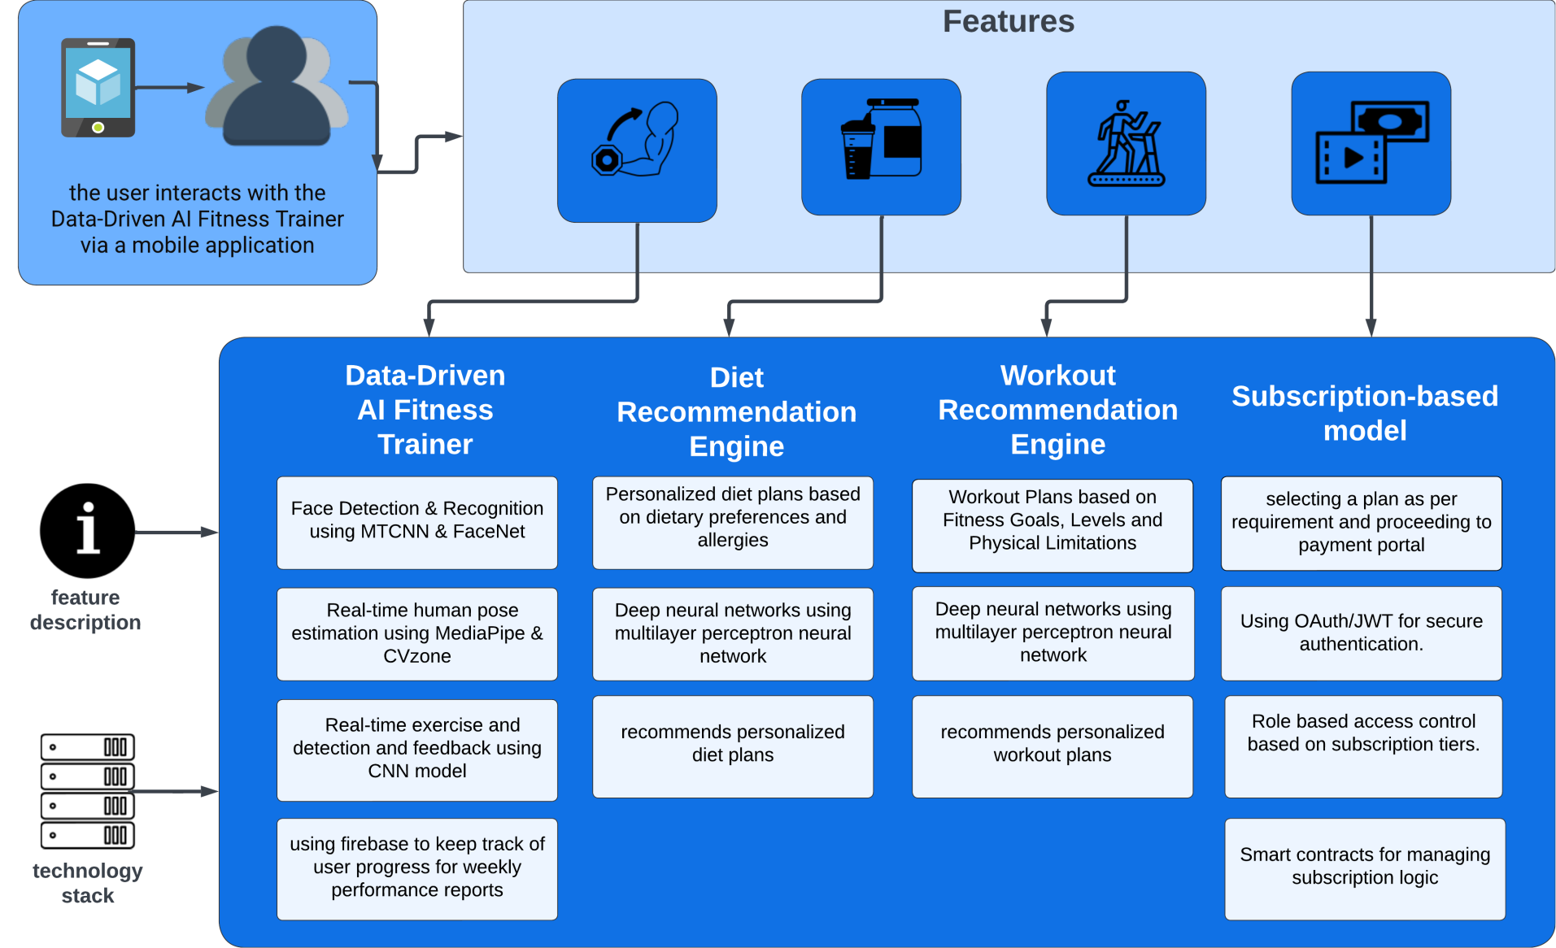
Proposed system architecture
Figure 3: Proposed system architecture

Slide 17


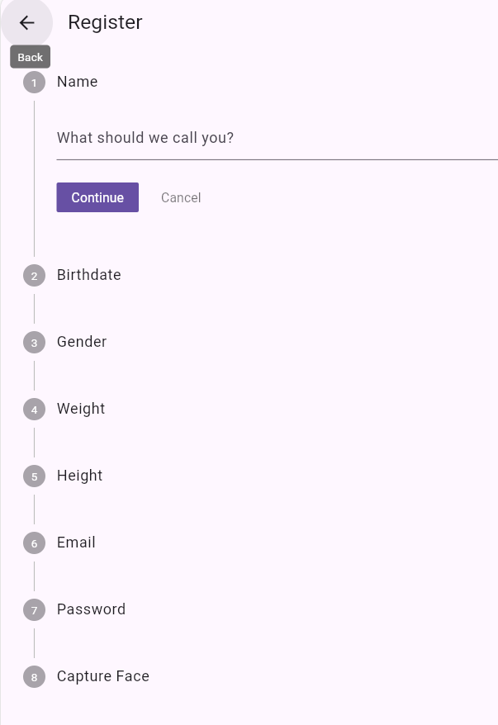

Prototype Design Demonstration

Slide 18

Prototype Design Demonstration

Slide 19
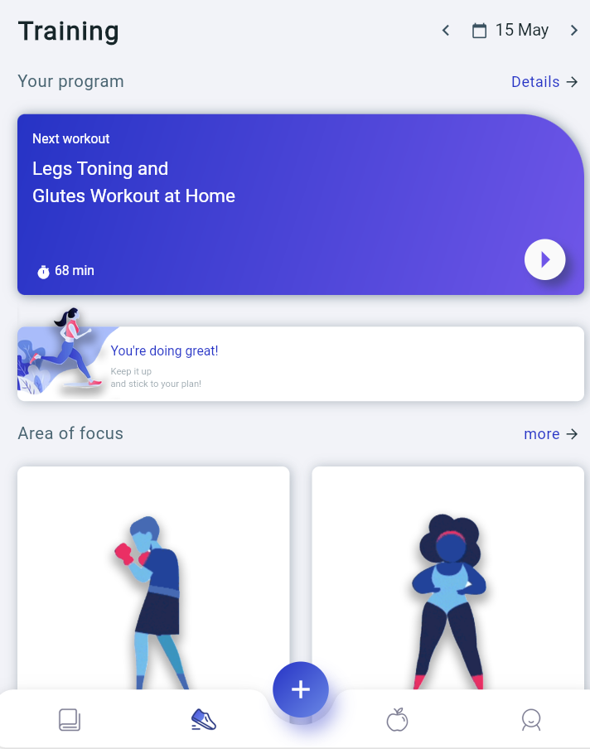
Prototype Design Demonstration

Slide 20
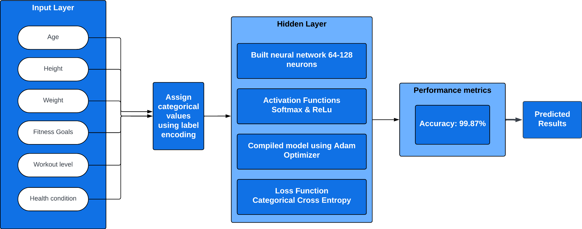
Implementation Status
Objective 1:
Figure 4: Recommendation Engine using MLP Approach

Slide 21
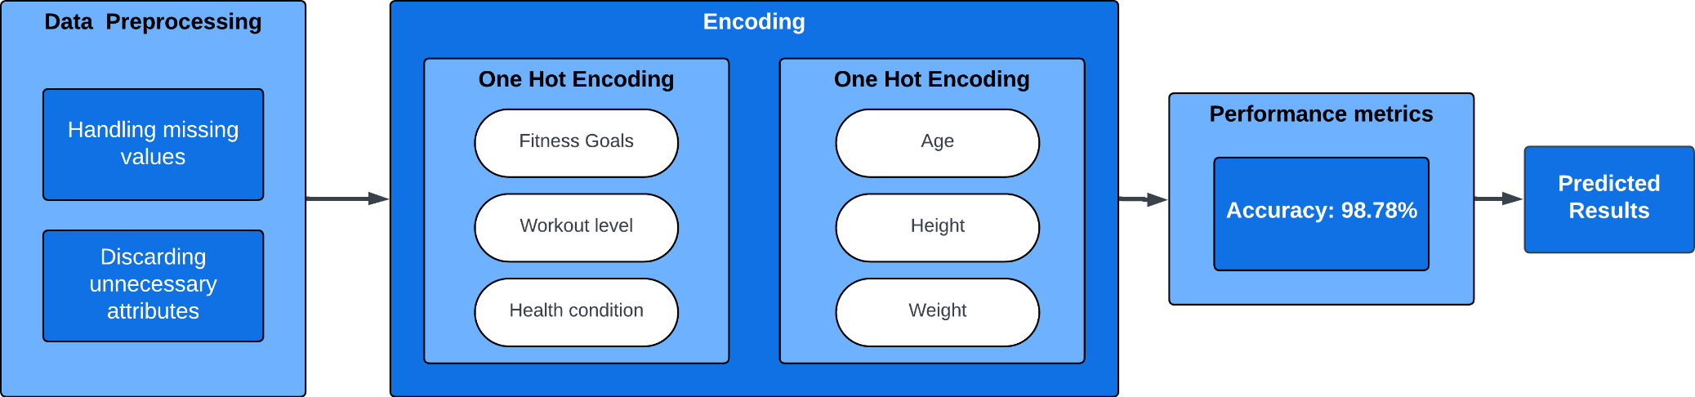
Implementation Status
Objective 1:
Figure 5: Recommendation Engine using Tensorflow Approach

Slide 22
Review Suggestions (Given in Last meeting)

Slide 23

References
Venkata Sai P Bhamidipati,Ishi Saxena, Mrs. D. Saisanthiya, Mrs. D. Saisanthiya,Dr. Mervin Retnadhas, Robust Intelligent Posture Estimation for an AI Gym Trainer using Mediapipe and OpenCV, 2023 International Conference on Networking and Communications (ICNWC),
M. Chariar, S. Rao, A. Irani, S. Suresh and C. S. Asha, "AI Trainer: Autoencoder Based Approach for Squat Analysis and Correction," in IEEE Access, vol. 11, pp. 107135-107149, 2023, doi: 10.1109/ACCESS.2023.3316009.
T. Callens, T. van der Have, S. V. Rossom, J. De Schutter and E. Aertbeliën, "A Framework for Recognition and Prediction of Human Motions in Human-Robot Collaboration Using Probabilistic Motion Models," in IEEE Robotics and Automation Letters, vol. 5, no. 4, pp. 5151-5158, Oct. 2020, doi: 10.1109/LRA.2020.3005892.
H. Cui and N. Dahnoun, "Real-Time Short-Range Human Posture Estimation Using mmWave Radars and Neural Networks," in IEEE Sensors Journal, vol. 22, no. 1, pp. 535-543, 1 Jan.1, 2022, doi: 10.1109/JSEN.2021.3127937.
Xu-na WANG, Qing-mei TAN, DAN: a deep association neural network approach for personalization recommendation, Frontiers of Information Technology & Electronic Engineering, vol. 7, 963–980, 2020.

Slide 24
Badiâa Dellal-Hedjazi, Zaiai Alimazighi, Deep learning for recommendation systems, 6th IEEE Congress on Information Science and Technology (CiSt), 2020.
Ram Murti Rawat, Vikrant Tomar, Vinay Kumar, An Embedding-based Deep Learning Approach for Movie Recommendation, 5th International Conference on Communication and Electronics Systems (ICCES), 2020.
Zhenhua Huang, Chang Yu, Juan Ni, Hai Liu, Chun Zeng, Yong Tang, An Efficient Hybrid Recommendation Model with Deep Neural Networks, IEEE Access, vol. 7, 2019.
Didar Divani Sanandaj, Sasan H. Alizadeh, A hybrid recommender system using multi layer perceptron neural network, 8th Conference of AI & Robotics and 10th RoboCup Iranopen International Symposium (IRANOPEN), 2018.
Al-Zahrani, Fahad Ahmad, Subscription-Based Data-Sharing Model Using Blockchain and Data as a Service, IEEE Access, vol. 8, 115966–115981, 2020.
Wenzheng Liu, Xiaofeng Wang, Wie Peng, State of the Art: Secure Mobile Payment,
IEEE Access, vol. 10, 2020
Yustus Eko Oktian, Elizabeth Nathania Witanto, Sandra Kumi, Sang-Gon Lee, BlockSubPay - A Blockchain Framework for Subscription-Based Payment in Cloud Service, 21st International Conference on Advanced Communication Technology (ICACT), 2019.
Jingwei Liu, Xiaolu Li, Lin Ye, Hongli Zhang, Xiaojiang Du, Mohsen Guizani, BPDS: A Blockchain Based Privacy-Preserving Data Sharing for Electronic Medical Records, IEEE Global Communications Conference (GLOBECOM), 2018.

Slide 25
Thank You!

